Slide 1
Assignment 4 – Report and Analysis on Hotel Reservation Dataset
Professor- Shriram Kadia
Name- Abhi Ajaybhai Patel
Student id- 200557634

Slide 2
Introduction :
This a data set choosen from the Kaggle that shows the history of the past reservations done by the customers based on their preferences on varied range of selections.
Reference:
Hotel Reservations Dataset | Kaggle
The dataset contains information about hotel bookings, such as Booking id, arrival date, departure date, number of adults/children, and whether the booking was canceled or not.
This dataset can be used for various classification tasks, such as predicting whether a booking will be canceled or not based on the given features. This can be useful for hotel management to predict potential cancellations and take actions to prevent them.
The dataset includes over 36,000 records and covers bookings made for hotel over a period of about two years.
This dataset is a valuable resource for hotel managers and analysts who are interested in understanding customer behavior, optimizing pricing and availability, and improving overall performance.

Slide 3
Description of Dataset and Valuable Insights
-To understand the trends and patterns of booking being made from the different platforms it is important to analyze the data from the past years in any business to grow the Business by getting certain predictive customers patterns.
Here, we have the Hotel reservation data which can be useful for us to make predictions ,By analyzing this dataset, we can gain insights into factors that influence customer booking behavior and cancellation rates, as well as identify opportunities for improving customer satisfaction and retention.
In this presentation, I will walk you through some of the most interesting findings from our analysis and discuss their implications for hotel management and decision-making. Whether you are a hotel manager, marketer, or analyst, I believe you will find this presentation informative and actionable. So, let's get started!"

Slide 4
Insights that can useful for Future predictions
How do lead time and booking channel (e.g., online travel agency, direct booking) affect cancellation rates? How can the hotel use this information to optimize marketing and distribution strategies?
Which factors are most predictive of cancellation, and how accurate are the predictions? How can the hotel use this information to improve its booking policies and procedures?
Which months or seasons have the highest cancellation rates? How can the hotel use this information to optimize pricing and availability during these periods?
How does the preferred room type vary across different market segments, and what is the distribution of bookings for each segment?
Repeated Guest Bookings trend such as Room type preferred,weekdays or weekend bookings and cancellations.

Slide 5
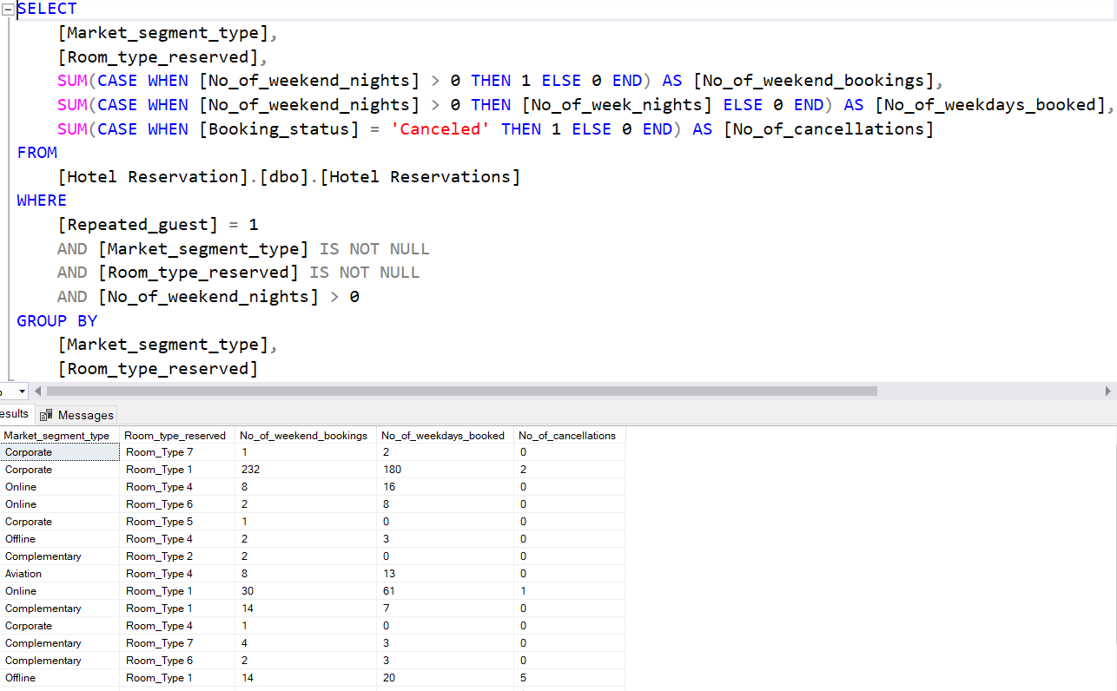
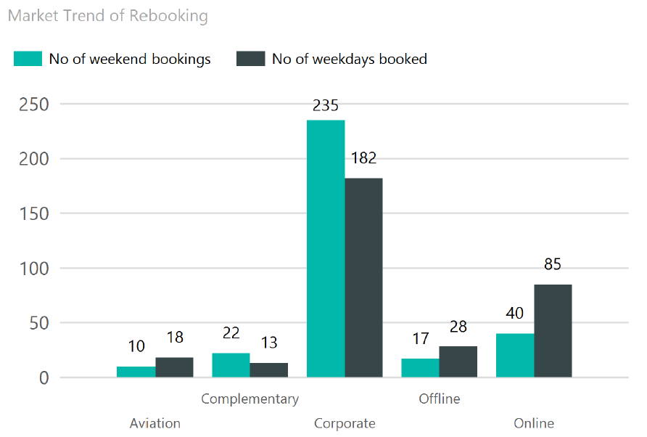
SQL queries :Trend of Rebooking and room preference

Slide 6
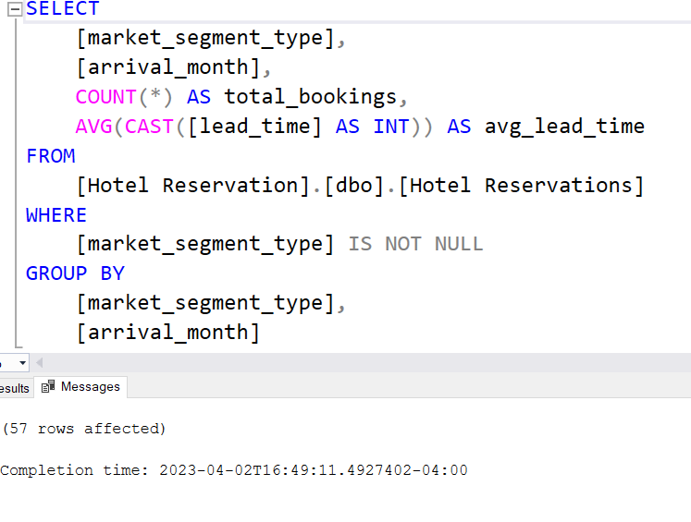
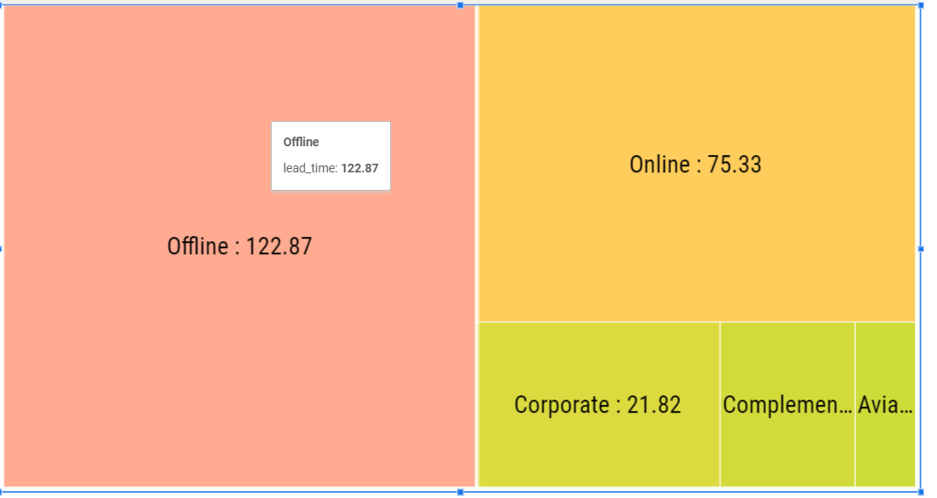
Sql Queries: Average lead time by month for online customers

Slide 7
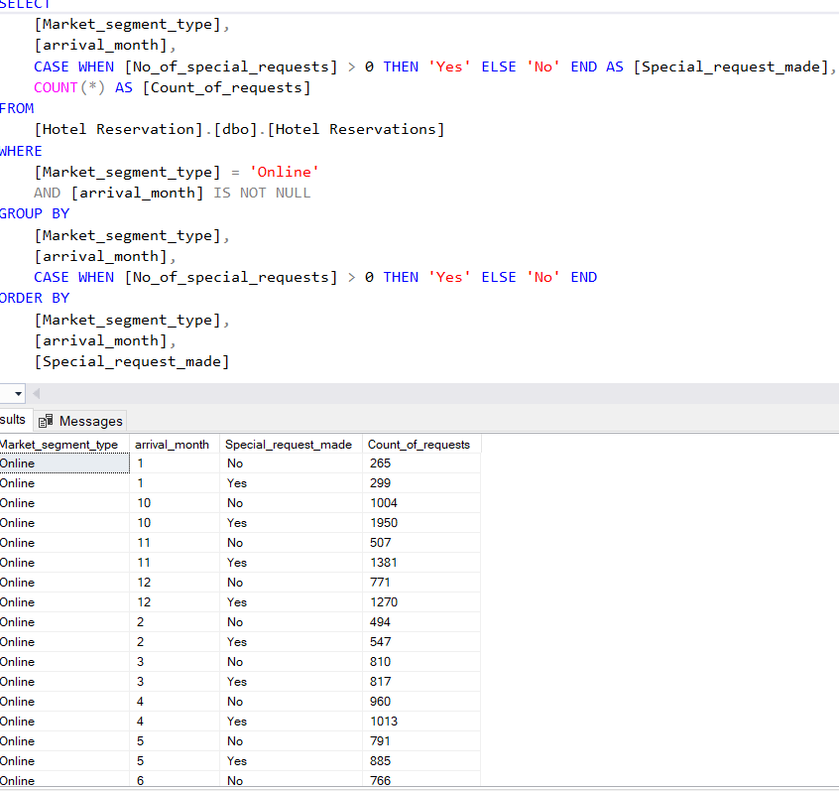
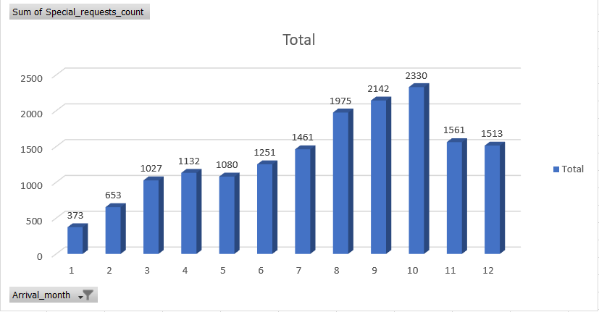
Sql Queries: Analyzing special request being made by the months for better staff allocation

Slide 8
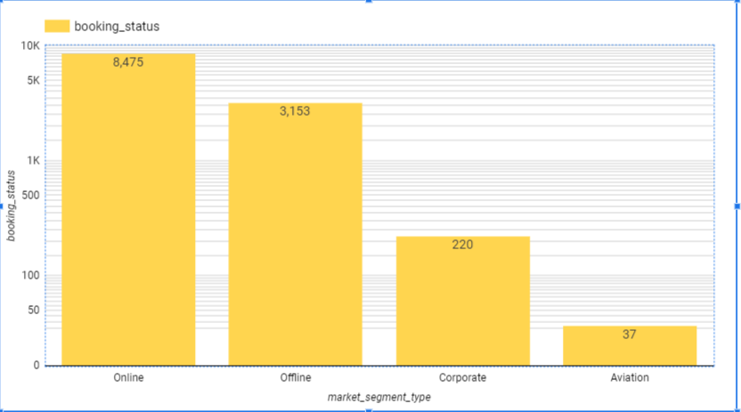
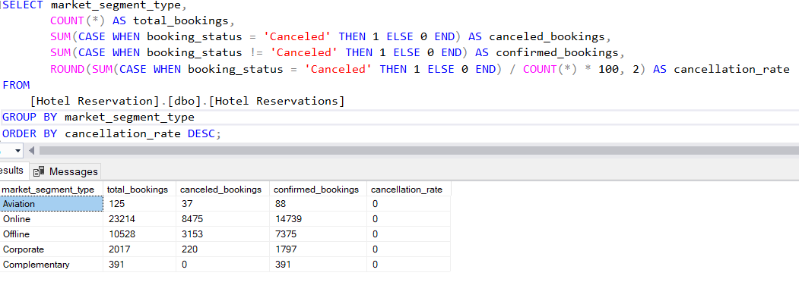
Sql Queries: Cancellation Ratio by different platforms for better policies by giving less refund

Slide 9
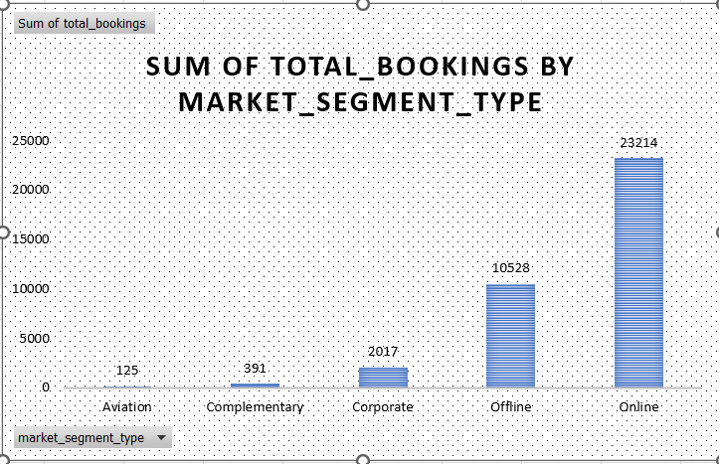
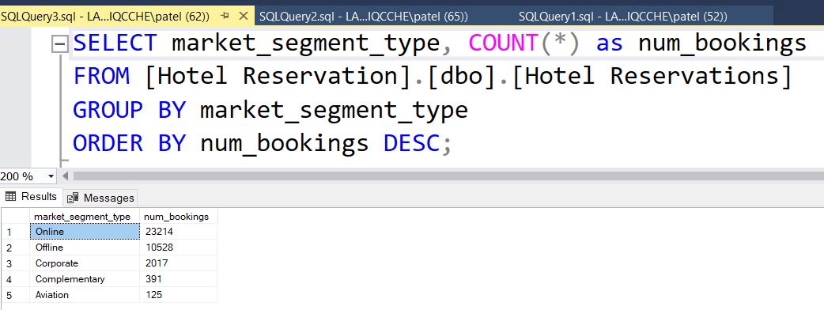
Sql Queries: No of Bookings(count) made by different platforms

Slide 10
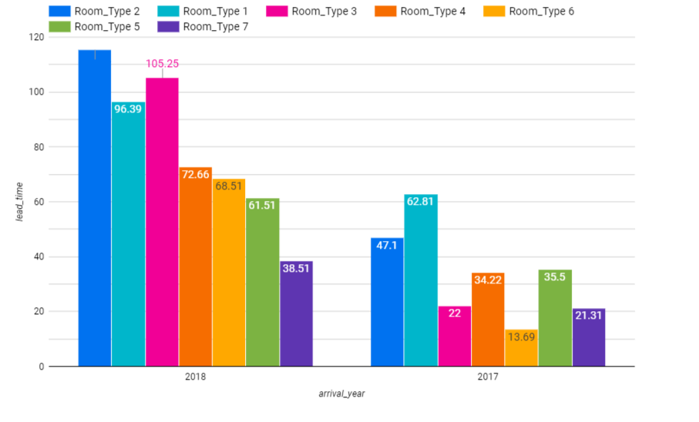
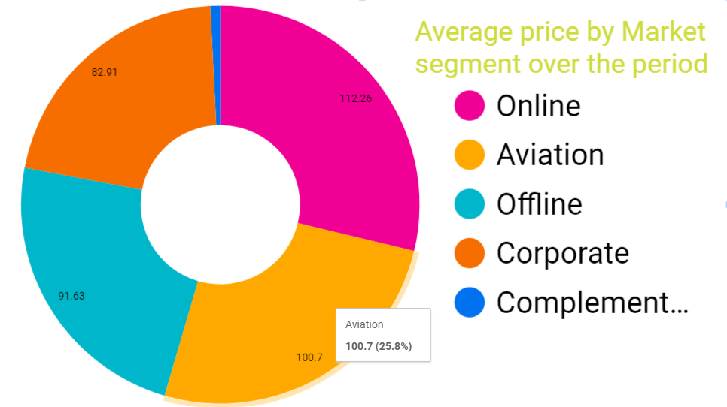
Clearly online , Aviation are two of the most profitable customers for Hotel based on the data we have analyzed.
-Lead time for the Room_Type_3 has been substantially grow from 22 days advance booked in 2017 to booked almost 3 months in advance.
Most Noticeable insight is Room type 2 which are booked almost 2.3 times more in advance then in previous month.

Slide 11

Predictions for future for better competitive prices,Resource allocation and cancellation rate of customers from the pattern of the past 2 years data.

Slide 12
From the findings we can say that over 60 percent of booking is made through online segment and followed by just over the 30 percent by offline segment which posses most of the bookings. Based on these we can improve our services and competive pricing which can bring more bookings from the corporate which are just
Also it is utmost important as a Hotel manager to understand that these huge online customer segment have almost 36.50 percent Booking Cancellation out of the total 23000 bookings. More stricter terms must be implemented so we can get alternative bookings from the other customers in that mean time.
In the last six month of the year there are most of the special request being made in the year of 2017-18 so to improve the services and faster response to customer requests It is more advisable to increase the staff of the Hotel employees during these period.
Also the lead time of the online customer is around 2.5 month in average and 4 month for offline segment.Eventhough the cancellation rate of one-third tells that the average price for online can be increased by 15 percent which is 112 dollars right now so we can compensate our losses through frequent cancellation.
By analyzing data most reservations well in advance are made in July, August, October So we can increase the prices in this rush time which can generate more revenue with commendable bookings already secured.
Customers mostly preferred the room type 1 and 3 according to the data of Repeated customers Also the weekend bookings are more for room type 1.So Hotels in future can expand business by converting room to these type.

Slide 13

Thank you

